Slide 1
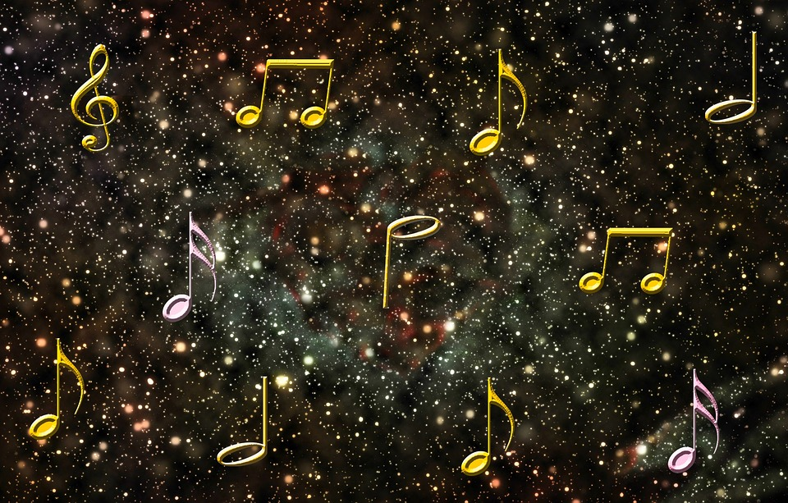

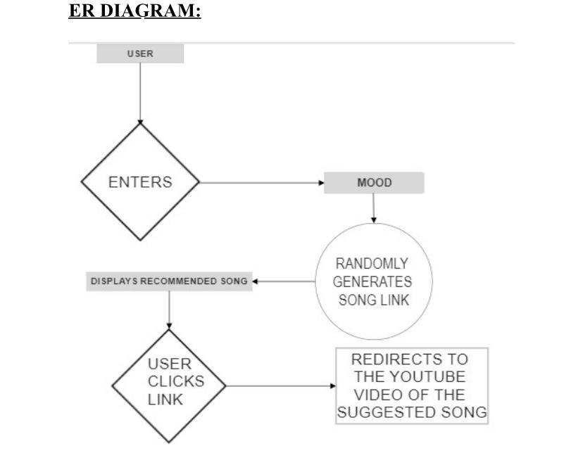

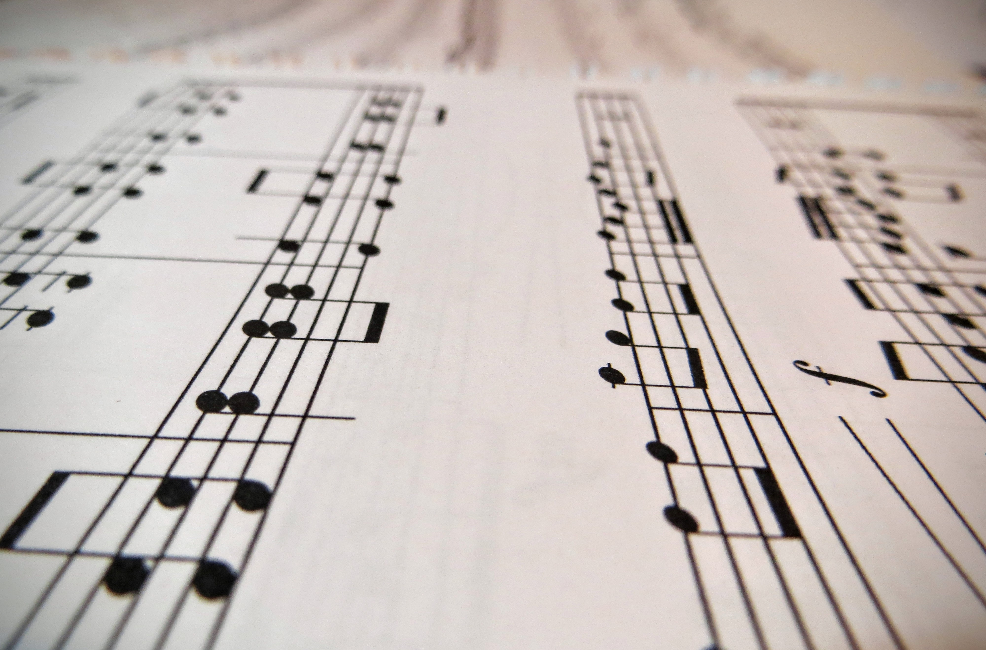

TITLE: TELL US HOW YOU FEEL AND LET THE MUSIC SPEAK!
SOOTHING THE HEART OF THE 21ST CENTURY INDIVIDUAL USING THE POWER OF TECHNOLOGY.
Music is a means of giving without attaching them to events or objects in the world.
Music reflects the mood & the mood changes with music
Music is a language that has transcended every single human barrier one can possibly conceive. Science has shown us that music positively affects the right side of the brain, which controls the body’s healing process.
TEAM MEMBERS:
Abhishek Herbert Samuel (21011102004)
G. Varun (21011102033)
Kota Sri Laasya (21011102050)
L. Karthikeya Reddy (21011102053)

